Slide 1
Portfolio Project 1: Open Source Intelligence

Slide 2
Introduction
My name is hasnain , and I am pleased to introduce myself to you. My father's name is fazal wahab, and I am a computer science student in uet peshawar. who has recently taken admission in IEC for cyber security. I am enthusiastic about technology and have always been intrigued by how it shapes the world we live in today..

Slide 3
Open source Intelligence project
OSINT, or Open Source Intelligence, refers to the collection, analysis, of information that is publicly available. This information can be gathered from a variety of sources, including social media, websites, news articles, and government publications.

Slide 4
TASK 1: You have been applying for entry-level cyber security jobs. You got an interview with the Keeber Security Group. They want to test your skills through a series of challenges oriented around investigating the Keeber Security Group. The first step in your investigation is to find more information about the company itself. All we know is that the company is named Keeber Security Group and they are a cybersecurity startup. To start, help us find the person who registered their domain.

Slide 5

Answer:
A simple google search for: Keeber Security Group gets us to the company’s website: keebersecuritygroup.com

Slide 6
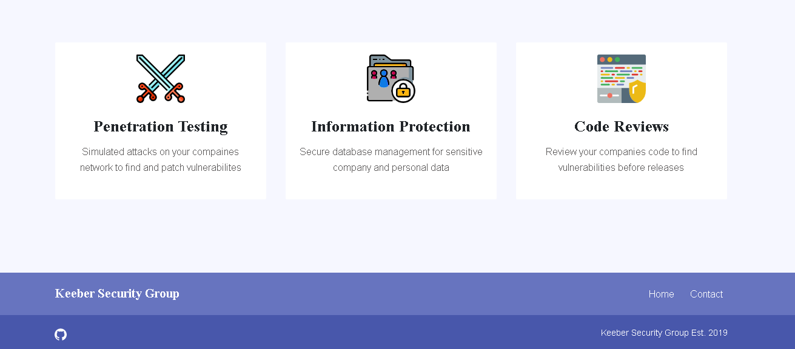

Slide 7
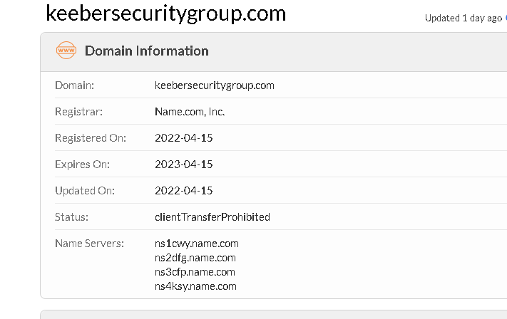
To identify who registered the site, I used the whois lookup website which retrieves various metadata about a given domain.

Slide 8
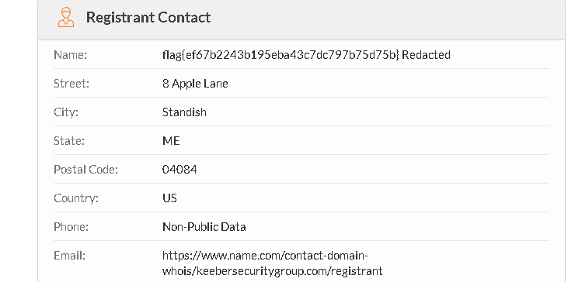

Slide 9
By running: whois keebersecuritygroup.com, we get the flag:
flag{ef67b2243b195eba43c7dc797b75d75b}
TASK 2: The Keeber Security Group is a new startup in its infant stages. The team is always changing and some people have left the company. The Keeber Security Group has been quick with changing its website to reflect these changes, but there must be some way to find ex-employees. Find an ex-employee through the website.

Slide 10
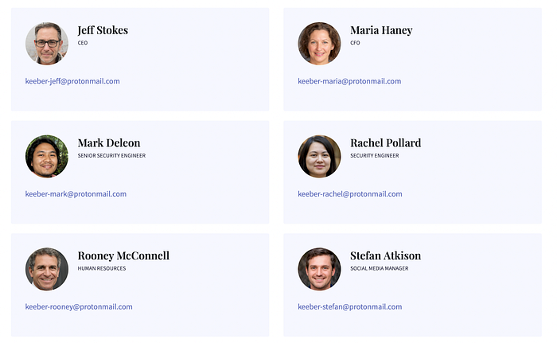
Answer:
Browsing to the Team section on the Keeber Security Group company website reveals 6 employees:

Slide 11
If you need to access information about an ex-employee on the Keeber Security Group website, you can use the Wayback Machine, which is an online archive of web pages. By searching for the team page, you can access previous versions of the website and find the desired information. To begin, you can check the oldest archived version available, which is from April 19th. From there, you can scroll down the page and locate the details about the ex-employee, Tiffany Douglas, and retrieve any necessary information. By utilizing this method, you can access valuable information that may no longer be available on the current version of the website.

Slide 12
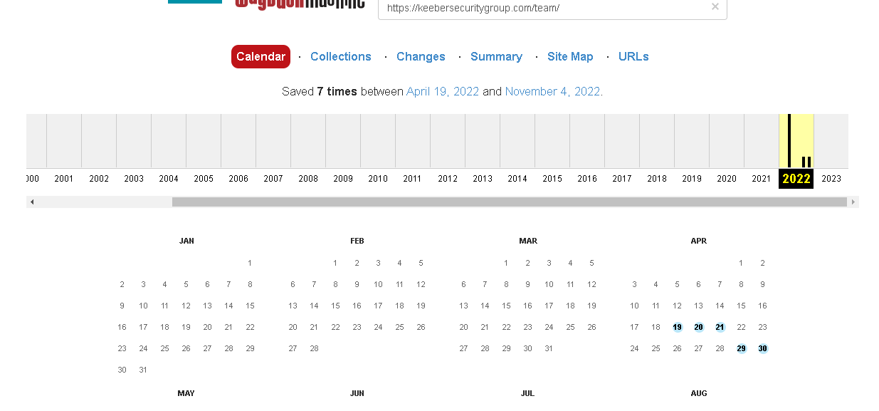

Slide 13
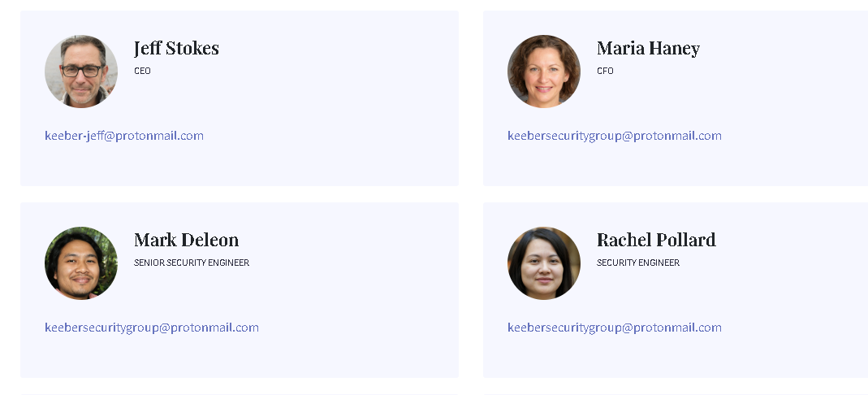

Slide 14
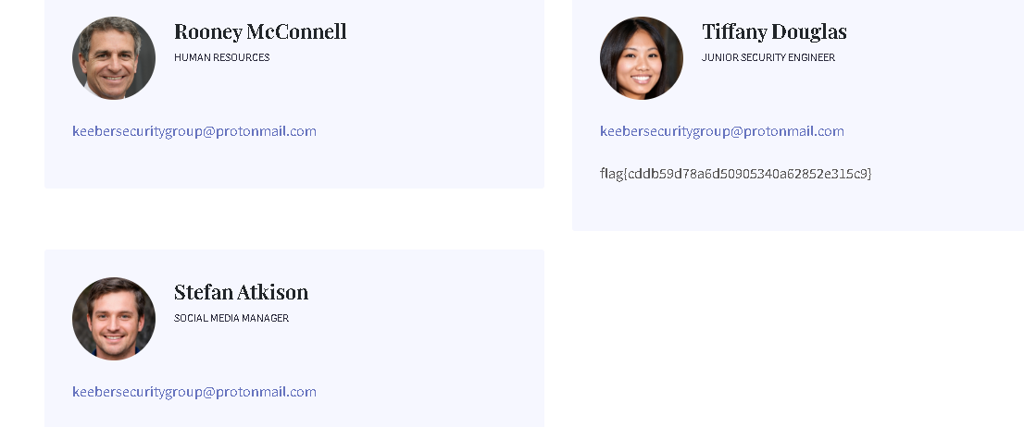

Slide 15
flag{cddb59d78a6d50905340a62852e315c9}
TASK 3: The ex-employee you found was fired for “committing a secret to public GitHub repositories”. Find the committed secret, and use that to find confidential company information. Also, find more information regarding the secret file.

Slide 16
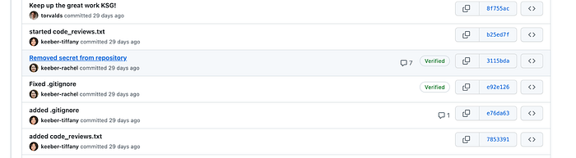
Answer:
The Keeber Security Group website contained a link to their Github account. By examining the commit history for the security-evaluation-workflow repository, we can see a suspicious commit message stating “Removed Secret from repository”

Slide 17
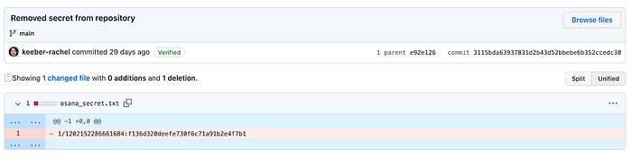
By clicking on the above-mentioned commit and looking at the we can see the actual secret in a file called asana_secret.txt.

Slide 18
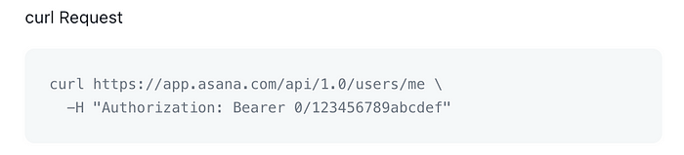
Upon initial inspection, the given information appeared to be limited. Therefore, I conducted an online search to gather more information about Asana and the potential usage of the provided string. After thorough research of the Asana documentation, I discovered a useful text box that explained how Curl could be utilized to access the Asana API.

Slide 19
As can be seen, the last parameter in the curl command resembles the secret we have identified in Git. This must be the API token.
TASK 4: The ex-employee also left the company password database exposed to the public through GitHub. Since the password is shared throughout the company, it must be easy for employees to remember. Find and open the password database and extract the flag. The password of the file is: craccurrelss

Slide 20
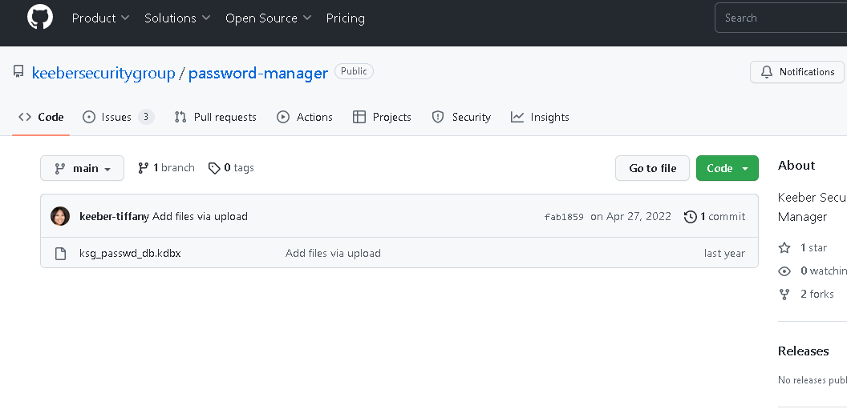
Answer:
first, we need to find the password database. We return to the company Github page and specifically examine the password-manager repository to find the desired database file:

Slide 21
I found the password database when solving Keeber 2, in the password-manager
If you come across a .kdbx file and are unfamiliar with its meaning, a quick Google search will inform you that it is typically associated with data files created by the KeePass Password Safe application.

Slide 22
On further searching, I found that this is a password database file for an application called KeePass, an open source password manager. To get the flag, we're required to get the password to this database file.
The password is craccurrelss which is fiven

Slide 23
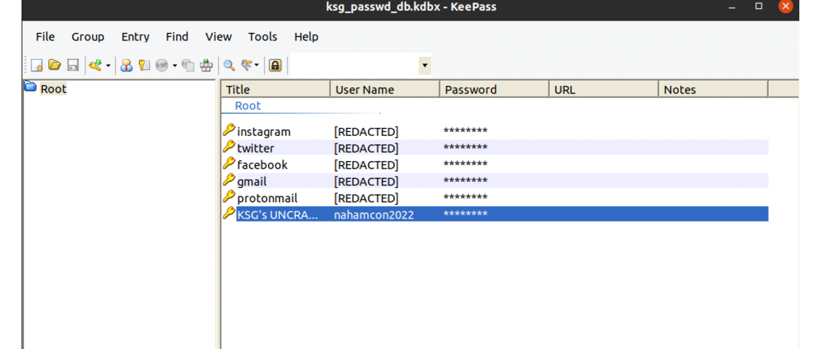
Before opening the password file, ensure that you have KeePass installed on your system. Then open the file, and enter the password.

Slide 24
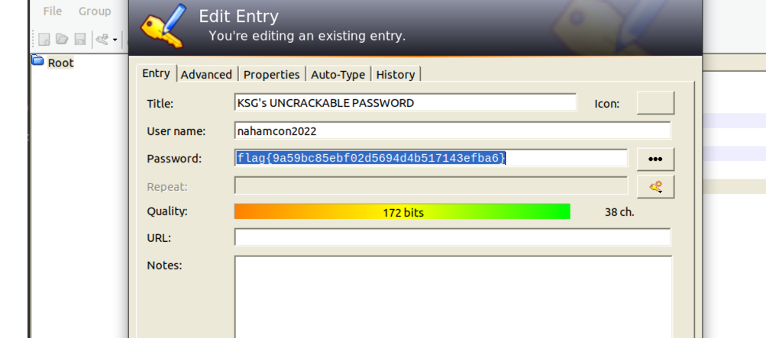

Slide 25
TASK 5: After all of the damage the ex-employees mistakes caused to the company, the Keeber Security Group is suing them for negligence! In order to file a proper lawsuit, we need to know where they are so someone can go and serve them. Can you find the ex-employee's new workplace? Her Instagram profile is: https://www.instagram.com/tif.hearts.science/ What is the name of her new work which is in the Maine area?

Slide 26

Answer:
Her Instagram account only contains 6 posts,
For example:

Slide 27


Slide 28
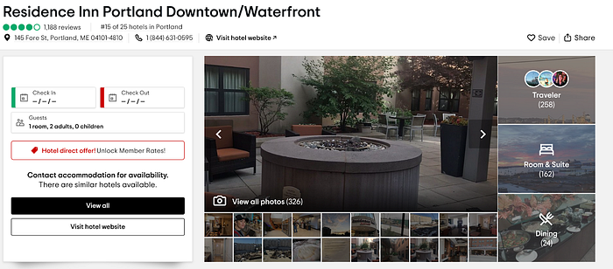
I went over to TripAdvisor and started going over hotels in the Maine Area that have an indoor pool, until I came across Residence Inn or more specifically, these images:

Slide 29
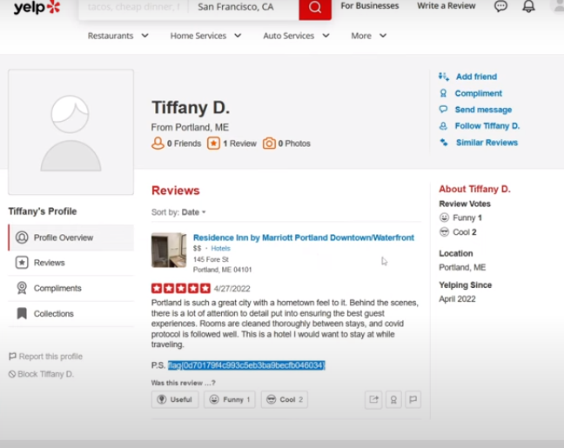

Slide 30
The name of her new work is Portland which is in the maine area .
TASK 6: Which company does this IP belong 54.239.28.85?
Answer:

Slide 31
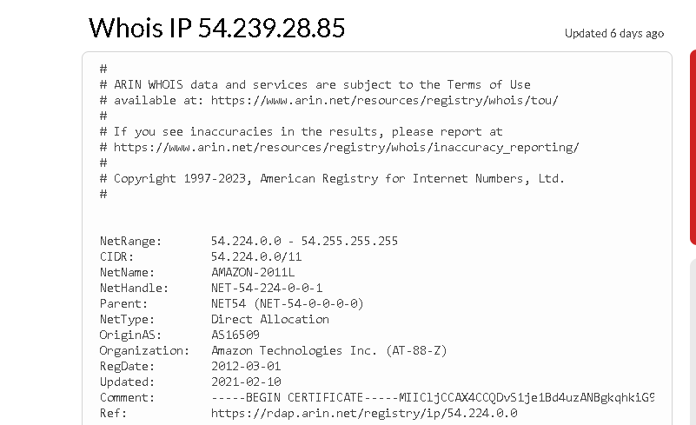

Slide 32
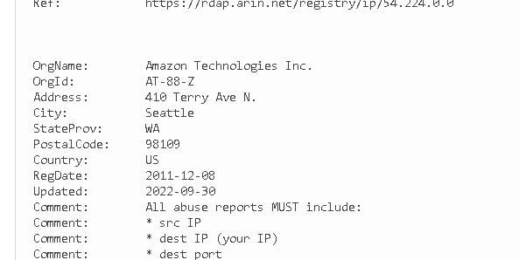

Slide 33
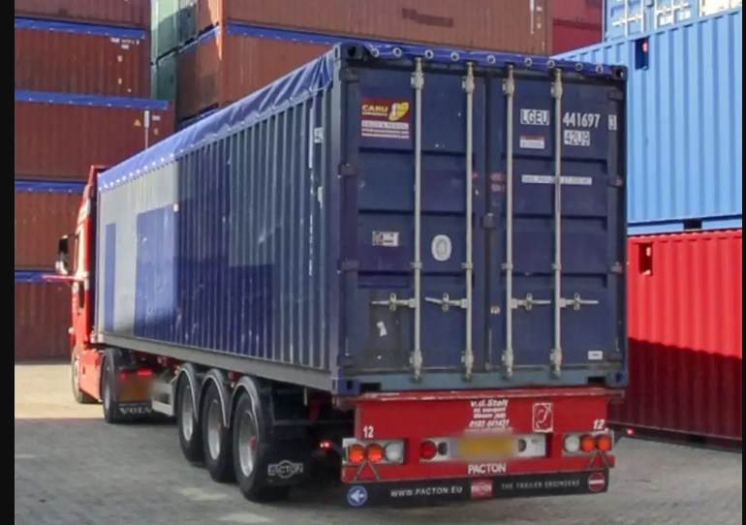
Company is amazon technologies inc.
TASK 7: What is the manufacturing date of this container? (Month and year only)

Slide 34
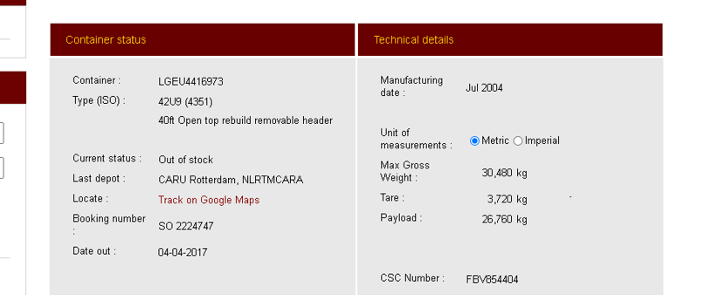
Answer:

Slide 35
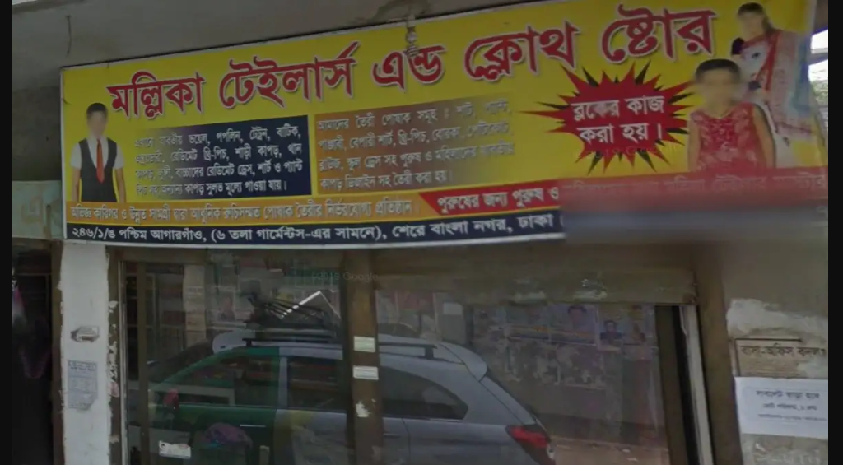
Manufacturing date of the container is jul 2004.
TASK 8: In which country this image is most likely taken?

Slide 36

Answer:

Slide 37

This image is taken in sher bangla nagar , dhaka
TASK 9: In which country is this vehicle registered?

Slide 38

Answer:
The Dacia Dokker is a panel van and leisure activity vehicle (LAV) built at the Renault factory in Tangier, Morocco.
TASK 10: Where did this plane land last as seen in the picture? Name of place?

Slide 39
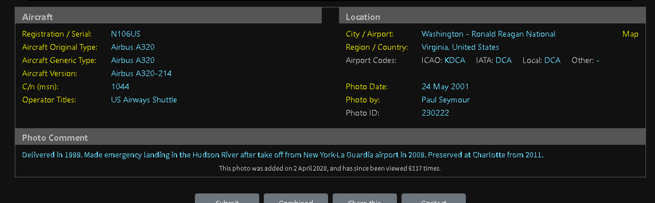
Answer:

Slide 40
Delivered in 1999, made an emergency landing in the Hudson river after take off from new york la gurdia airport in 2009.

Slide 41
Conculsion
In conclusion, the investigation into Keeber Security Group revealed several security vulnerabilities that could potentially put the company and its clients at risk. The discovery of an ex-employee who leaked confidential information on a public GitHub repository highlights the importance of proper access control and employee training on data handling. The exposure of the company's password database further emphasizes the need for secure password management practices. Additionally, the identification of the ex-employee's new workplace through social media serves as a reminder to individuals to be mindful of the information they share online.

